Slide 1
Introduction to Robotics
CSE 461
PID Practice Problem
Rafid Ahnaf

Slide 2

Question
A car is equipped with a PID controller to maintain a constant speed of 100 km/h on a straight road. Due to external disturbances, such as wind resistance and slope, the car's speed fluctuates. The initial speed of the car is 60 km/h.
The system has the following parameters:
Kp​=0.5, Ki=0.1, Kd=0.05
The car accelerates based on the controller output, and the new speed is given by:
New Speed = Previous Speed + Output
Simulate 5 time steps of the car's speed control, calculating the error, output, and new speed at each step.
By default, consider that all three sub controllers are employed from the very beginning

Slide 3
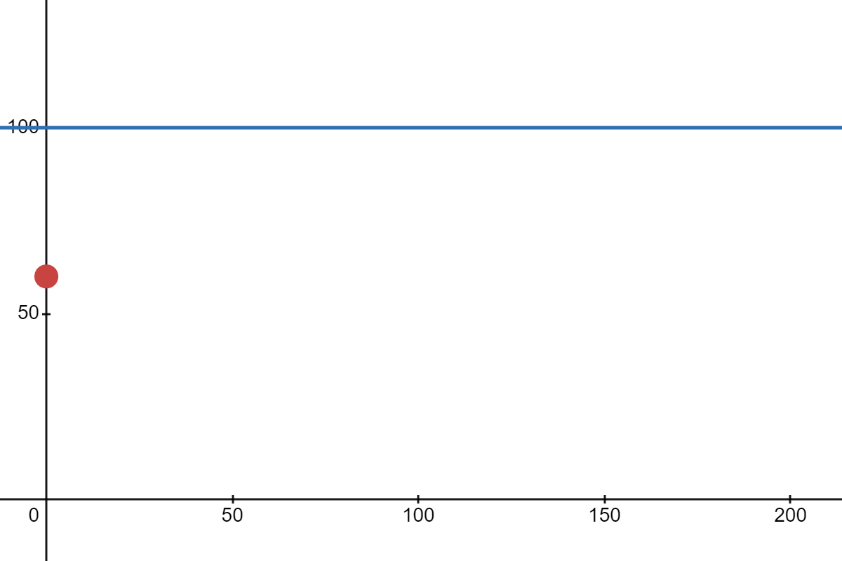
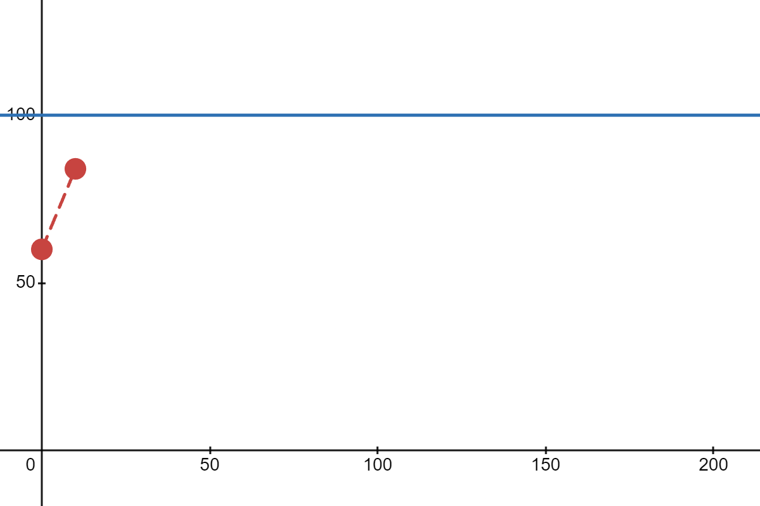
Step-by-step Calculation:
Step 1: At time t_1​:
Previous Speed = 60 km/h
Error = 100 − 60 = 40 km/h
Output = (0.5⋅40)+(0.1⋅40)+(0.05⋅0) = 20+4+0 = 24 km/h
New Speed = 60+24 = 84 km/h

Slide 4
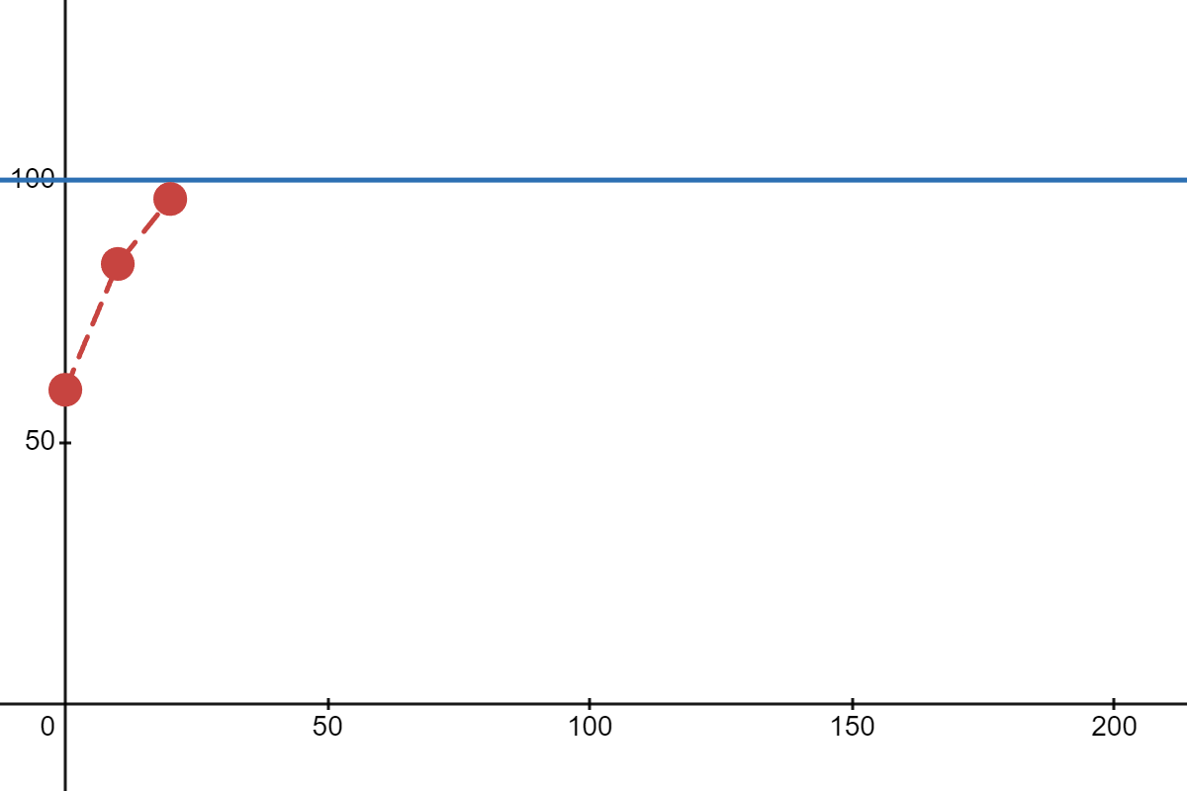
Step-by-step Calculation:
Step 2: At time t_2:
Previous Speed = 84 km/h
Error = 100−84 = 16 km/h
Output = (0.5⋅16)+(0.1⋅(40+16))+(0.05⋅(16−40)) = 8+5.6−1.2 = 12.4 km/h
New Speed = 84+12.4 = 96.4 km/h

Slide 5
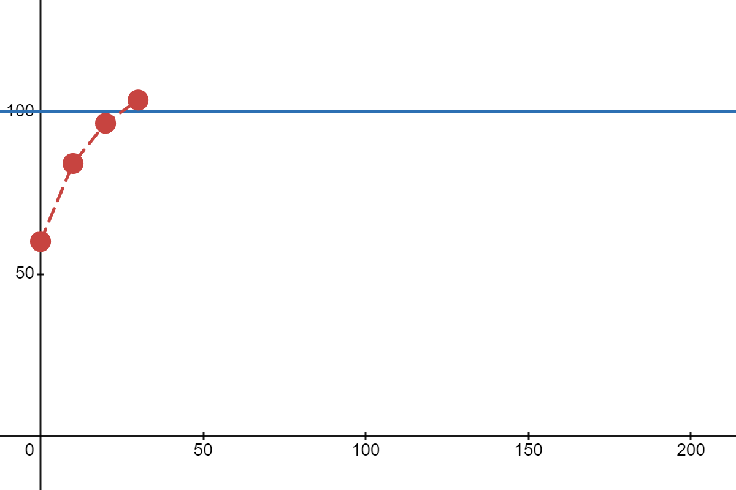
Step-by-step Calculation:
Step 3: At time t_3:
Previous Speed = 96.4 km/h
Error = 100−96.4 = 3.6 km/h
Output = (0.5⋅3.6)+(0.1⋅(40+16+3.6))+(0.05⋅(3.6−16)) = 1.8+5.96−0.62 = 7.14km/h
New Speed = 96.4+7.14 = 103.54 km/h

Slide 6
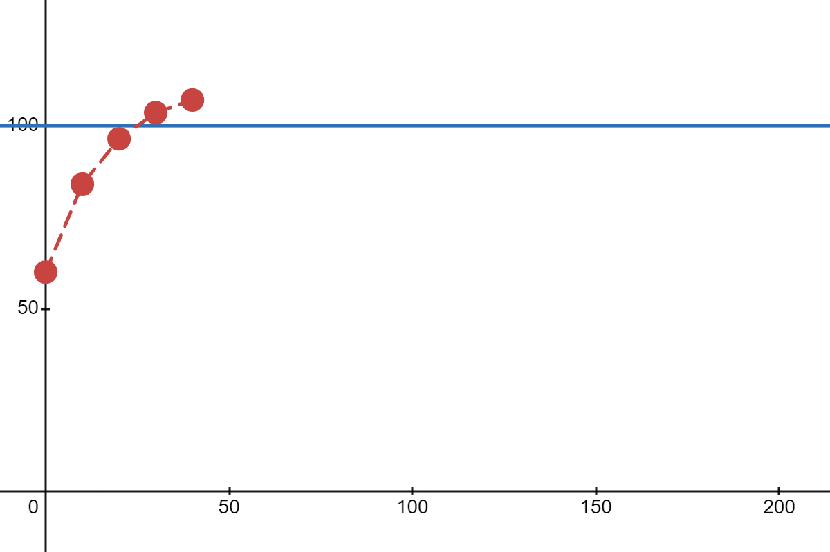
Step-by-step Calculation:
Step 4: At time t_4​:
Previous Speed = 103.54 km/h
Error = 100 − 103.54 = −3.54 km/h
Output = (0.5⋅−3.54)+(0.1⋅(40+16+3.6−3.54))+(0.05⋅(−3.54−3.6)) = −1.77+5.6−0.36 = 3.47km/h
New Speed = 103.54+3.47=107.01 km/h

Slide 7
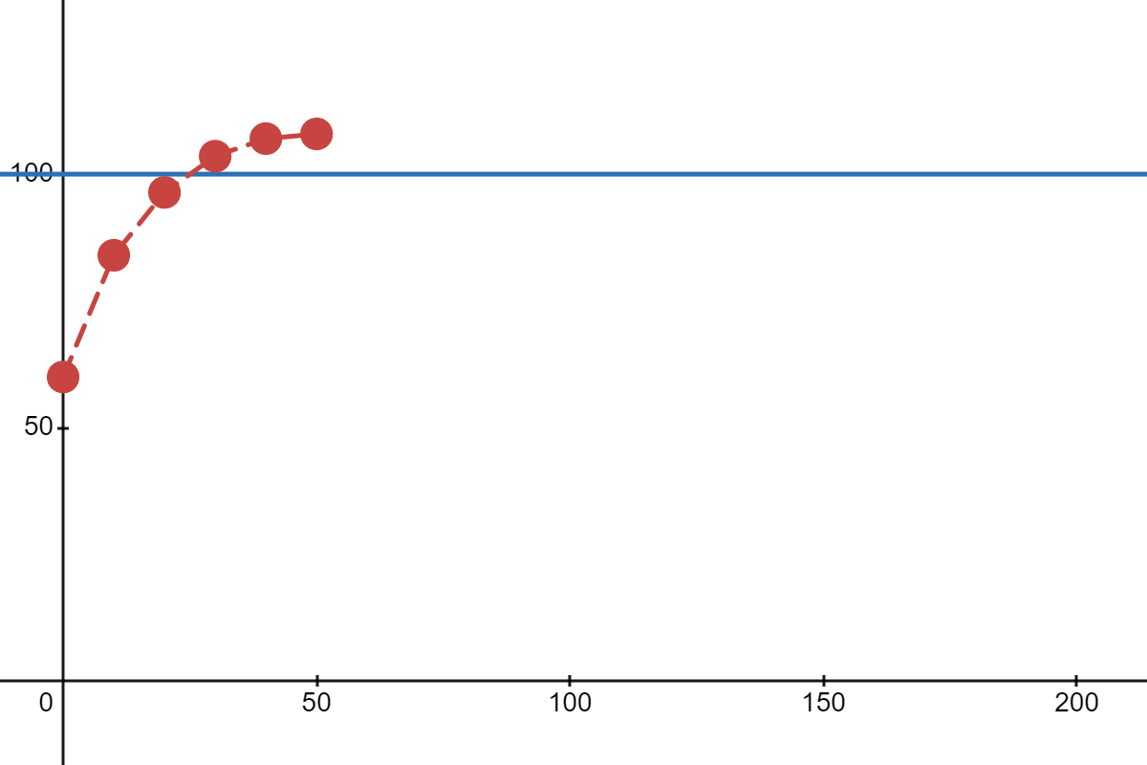
Step-by-step Calculation:
Step 5: At time t_5:
Previous Speed = 107.01 km/h
Error = 100−107.01 = −7.01 km/h
Output = (0.5⋅−7.01)+(0.1⋅(40+16+3.6−3.54−7.01))+(0.05⋅(−7.01−(−3.54))) = −3.51+4.6−0.17 =0.92km/h
New Speed = 107.01+0.92 = 107.93 km/h

Slide 8
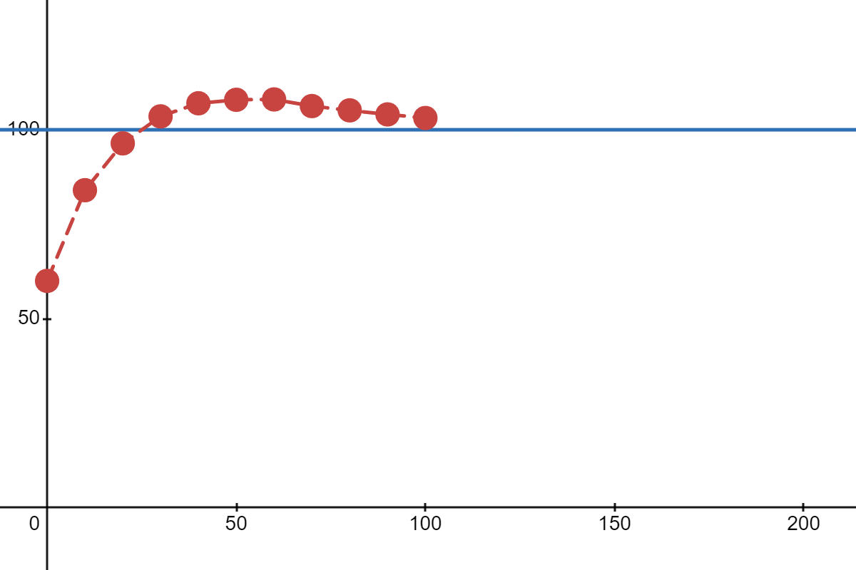
Step-by-step Calculation:
At time t_10

Slide 9
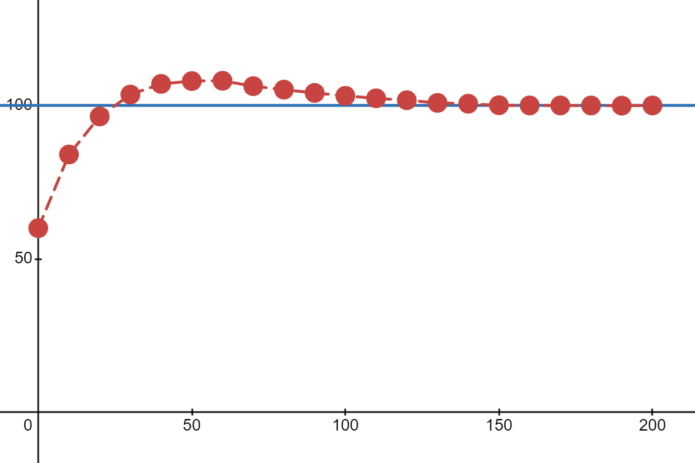
Step-by-step Calculation:
At time t_20

